Slide 1
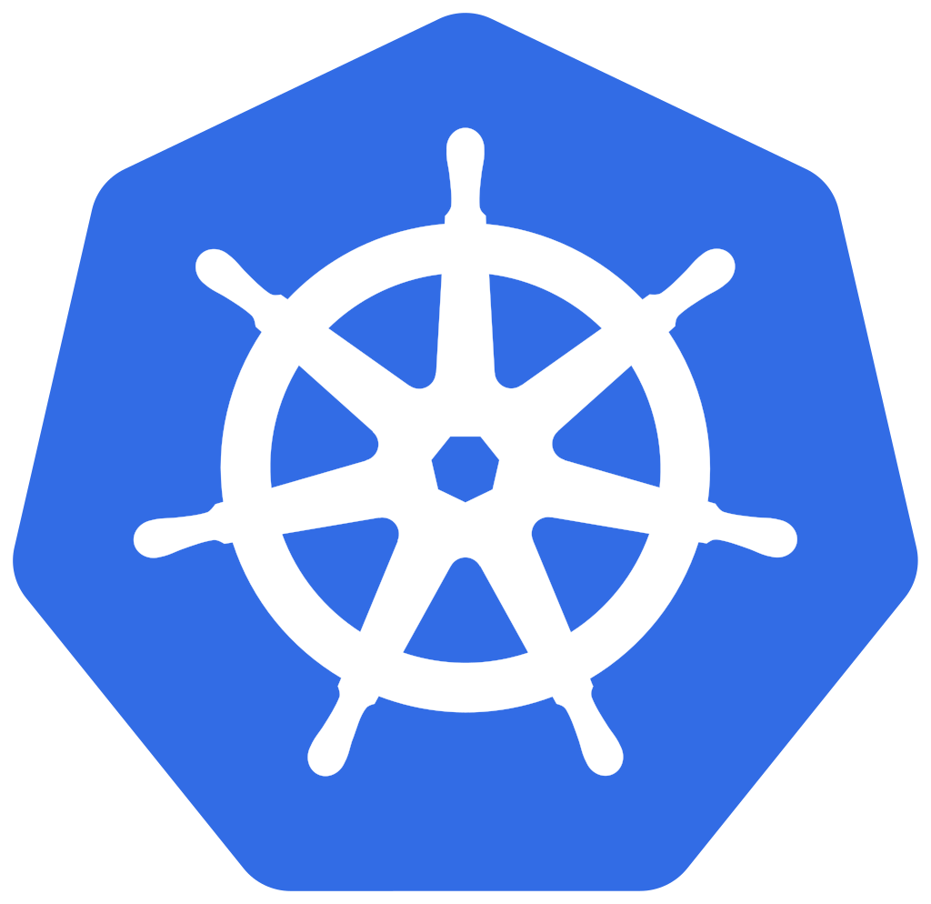
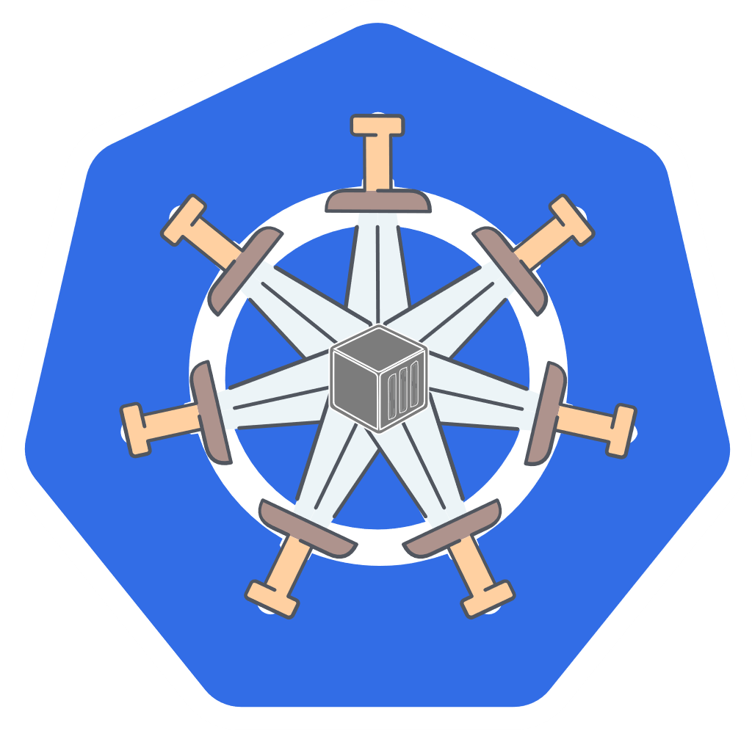
Kubernetes
An Introduction to an important component of EKScalibur platform
EKScalibur ecosystem

Slide 2
Slide 9
In the beginning…
APPLICATION
OS
Bare metal
installation
Responsibility
HARDWARE
Security
Testing
9

Slide 3
Slide 9
The first virtualization
revolution
A
A
A
A
OS
OS
OS
OS
Virtual Machines
Hypervisor
OS
Responsibility
HARDWARE
Security
Testing
9

Slide 4
Slide 9
The cloud revolution
A
A
A
A
OS
OS
OS
OS
Cloud Virtual
Machines
Hypervisor
OS
Responsibility
HARDWARE
Security
Testing
9

Slide 5
Slide 9
And now containers
A
A
A
A
A
A
A
A
A
A
A
A
Containers
Container Engine
OS
Responsibility
HARDWARE
Security
Testing
9
Notes:
Advantages of containers
Faster time to market
Development Velocity
Resource efficiency and density
Performance
Scaling – Never Outgrow
Security – Reduced Attack Vector
IT operational efficiency
Cost savings - Density
Speed - deploy in seconds
Agility
Freedom of choice – Language agnostic
Platform independence: Build it once, run it anywhere

Slide 6
Disadvantages of containers
Management
Scaling
Security, Auditing & Compliance
Development & Deployment
Monitoring
Reliability

Slide 7

What is Kubernetes?
Kubernetes is a portable, extensible, open-source platform for managing containerized workloads and services.

Slide 8
And this is why K8s
Management
Scaling
Security, Auditing & Compliance
Development & Deployment
Monitoring
Reliability
Orchestration, Desired State Management, Dashboards, Resource Management, Storage Management
Cluster and Application – Scale out, Scale up globally
RBAC, Policy Management, Secret & Configuration Management, Enforced TLS, Credentials Management
Service Discovery, Load Balancing, Automated Deployments, Roll backs, Replica Sets
Logging & Tracing
Self Healing, Health checking, True Multi-Cluster

Slide 9
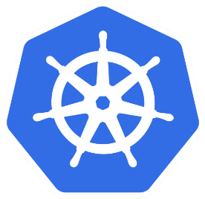
The short history of Kubernetes
CONTAINERS
KUBERNETES
2004
2014
BORG
KUBERNETES v1.0
2006
2015
Story: https://kubernetes.io/blog/2015/04/borg-predecessor-to-kubernetes/
Paper: https://research.google/pubs/pub43438/

Slide 10
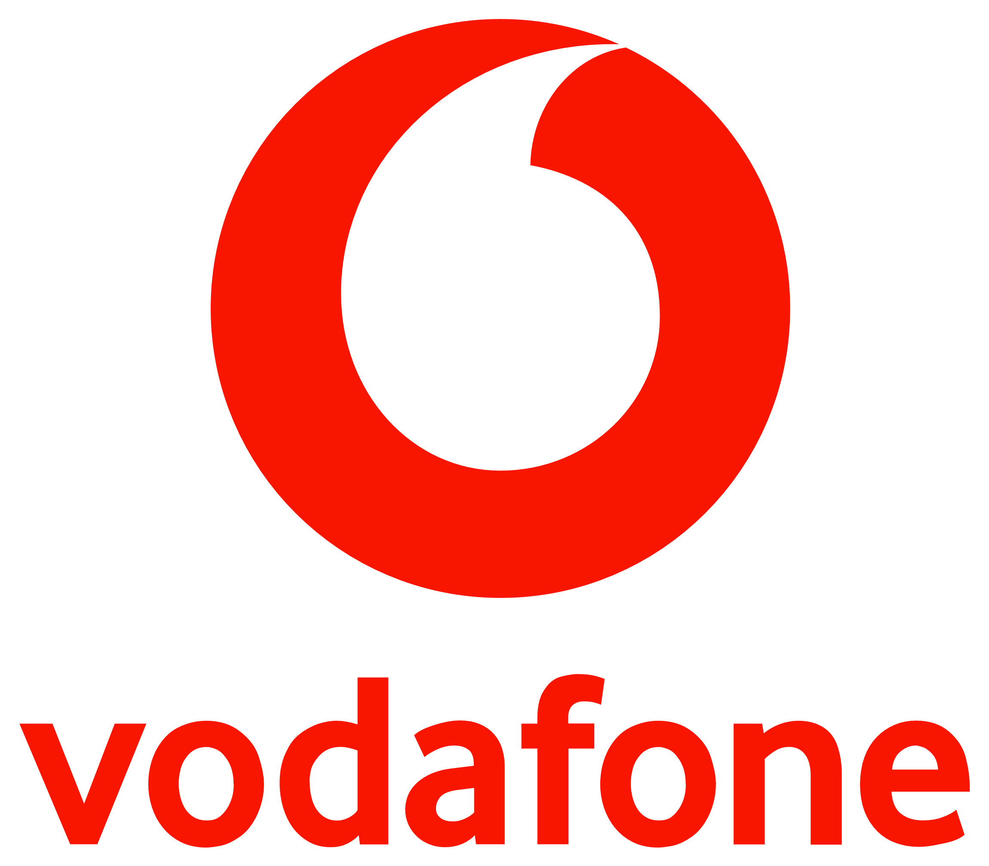
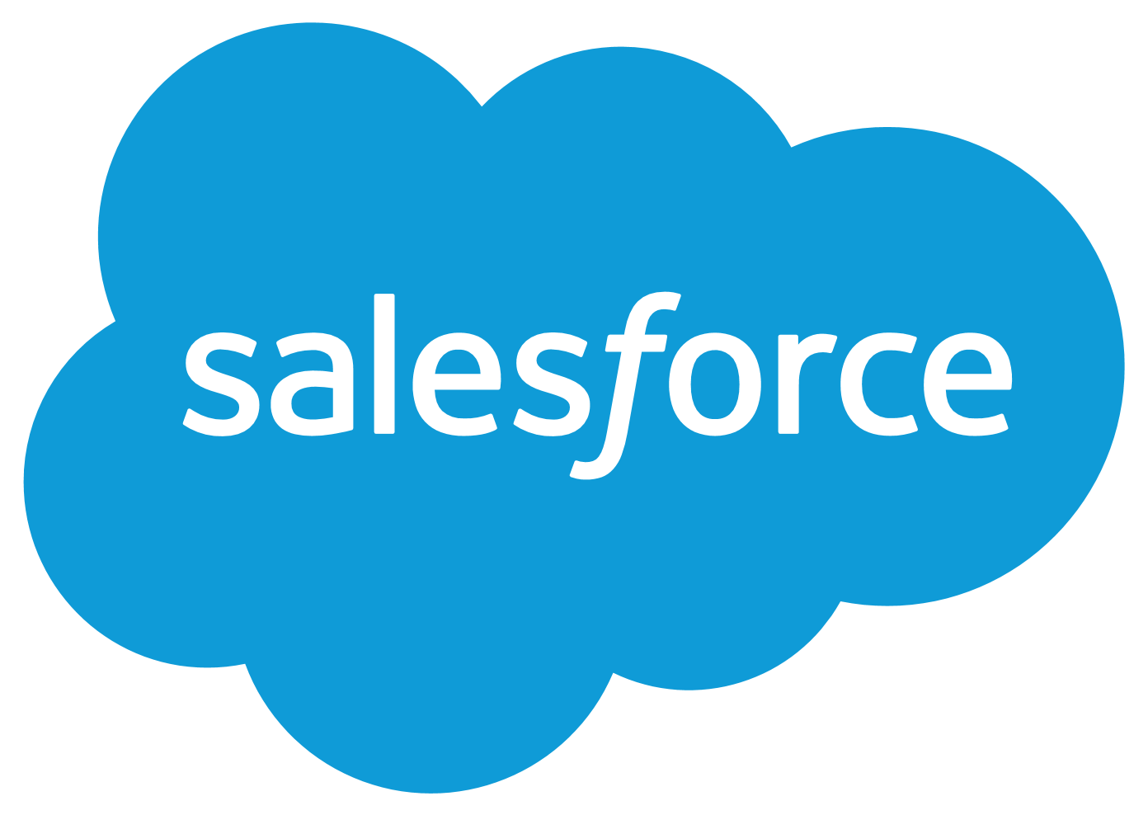
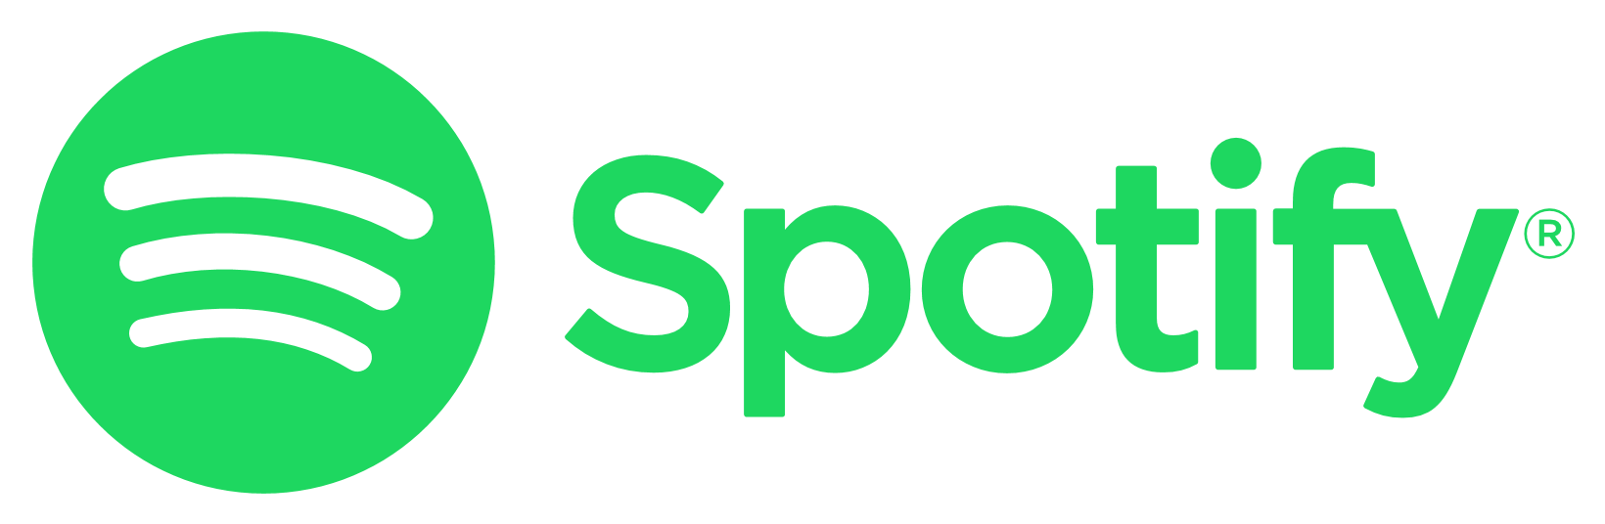

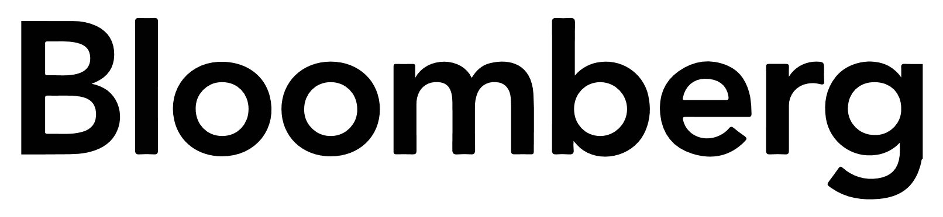



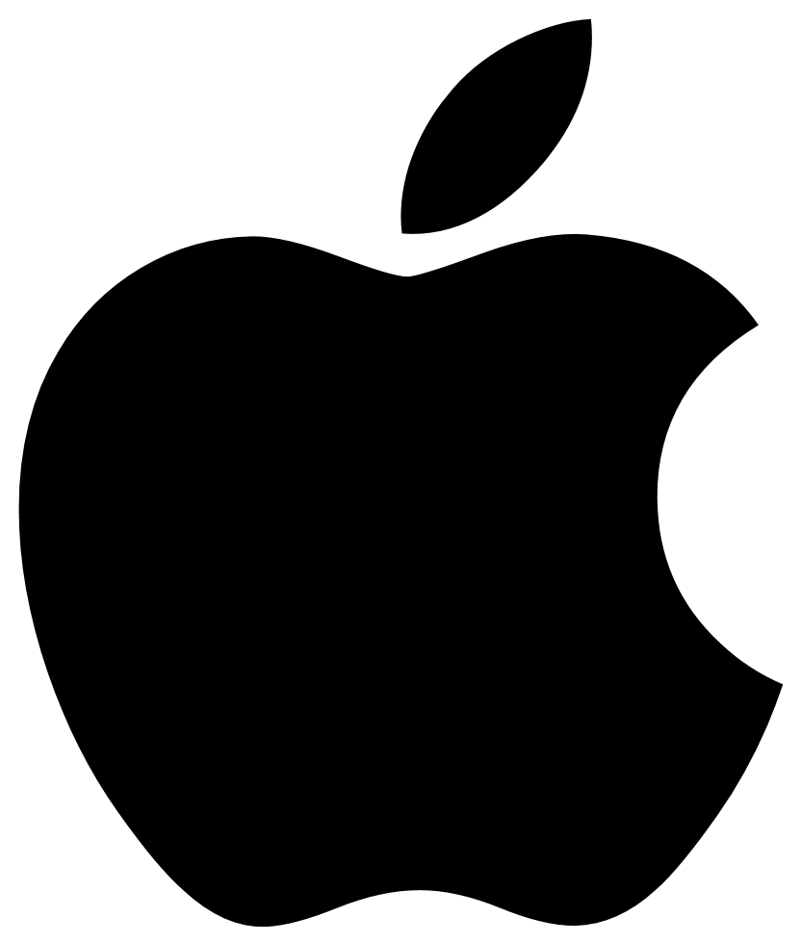
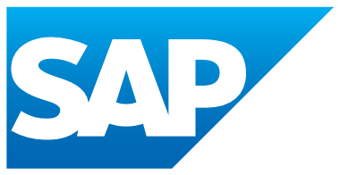



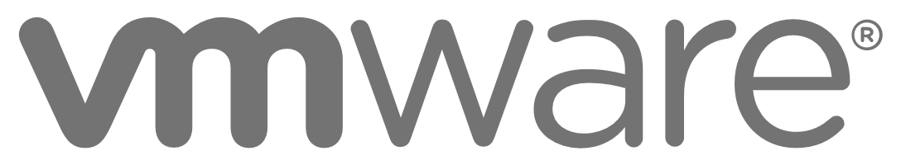



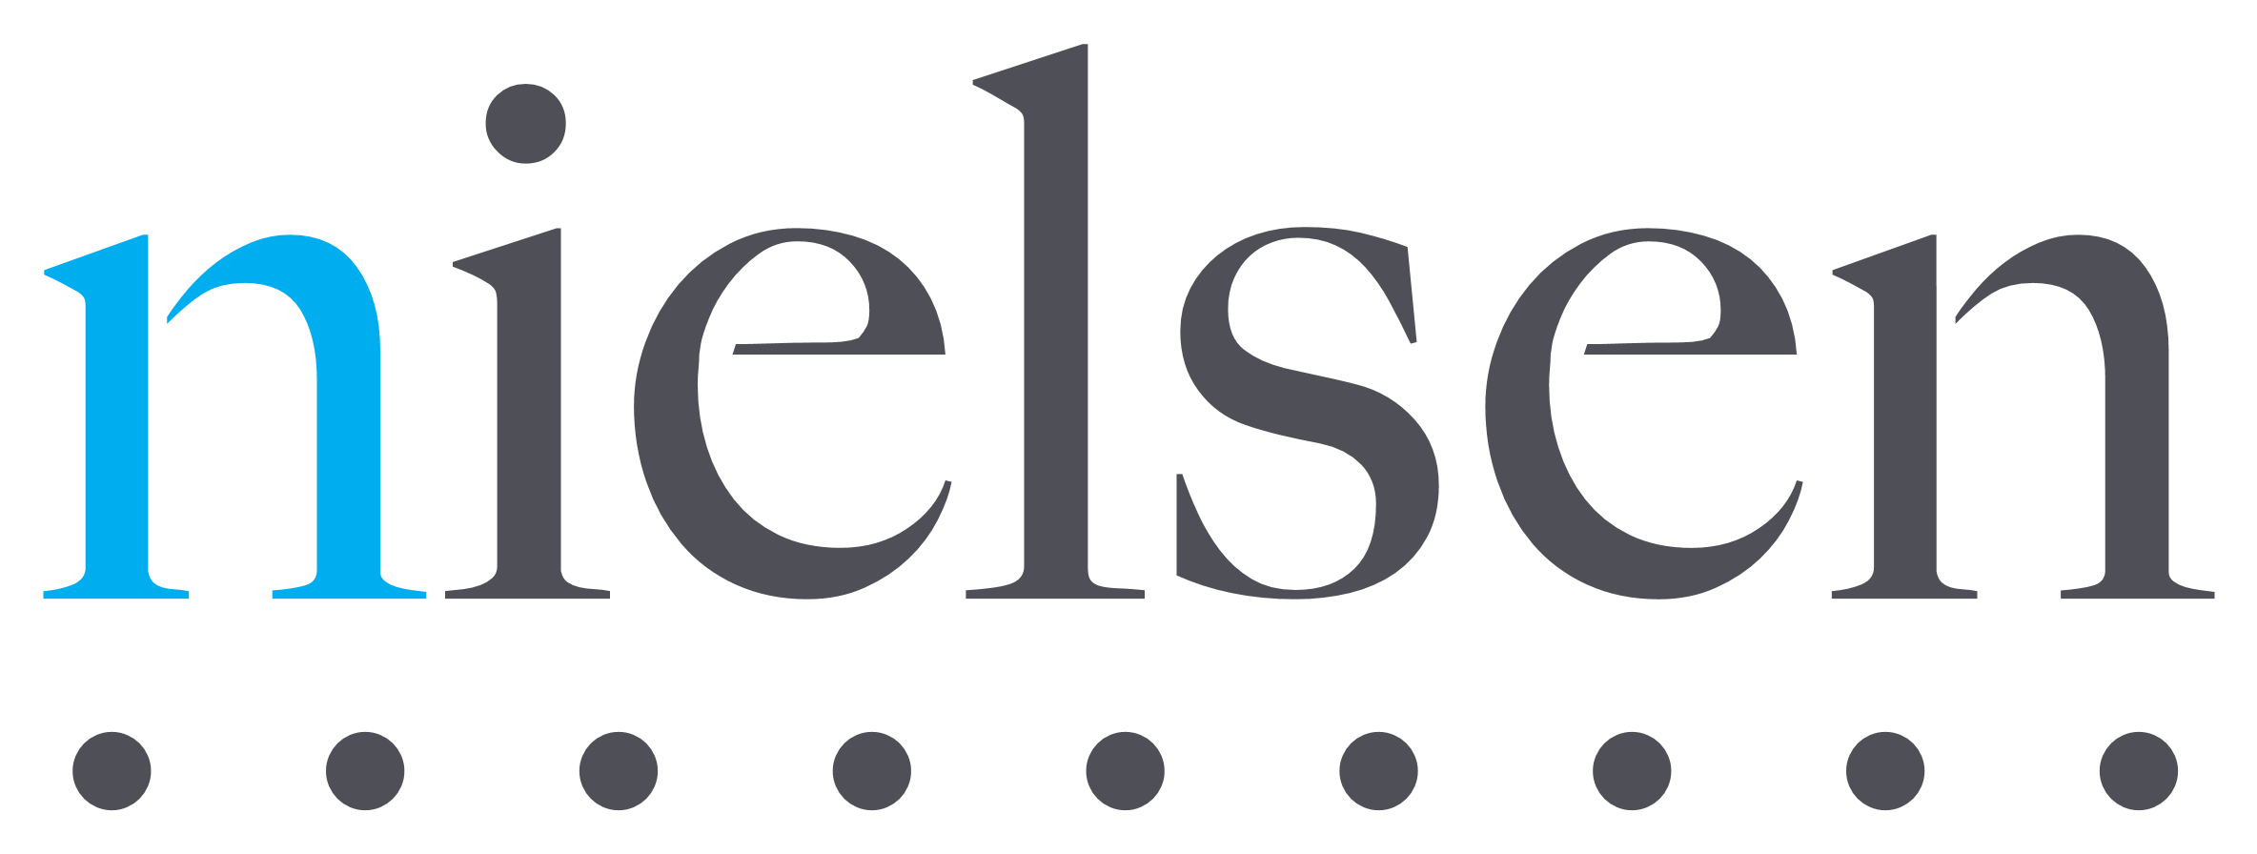

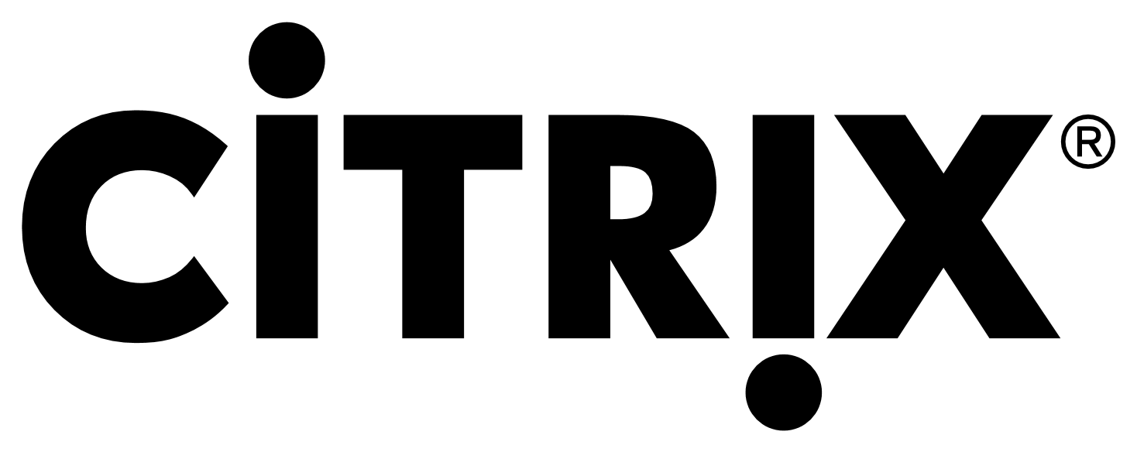
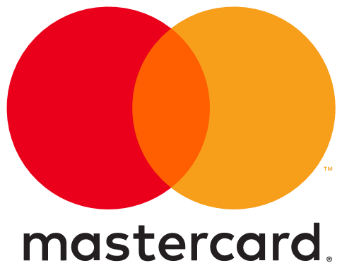
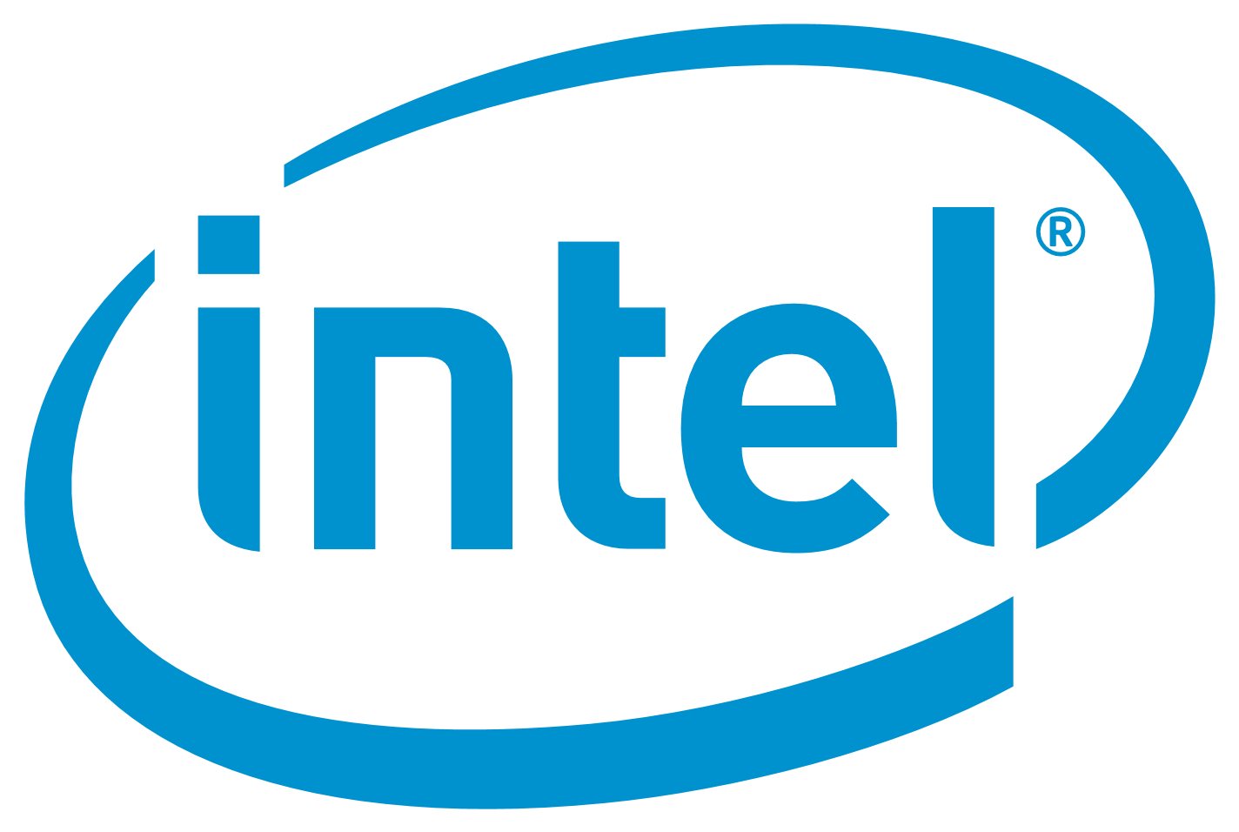
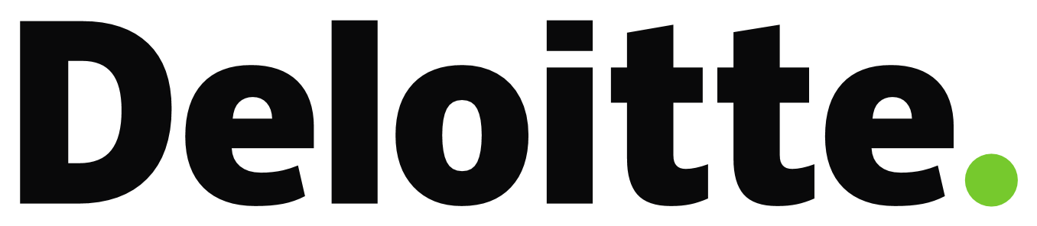

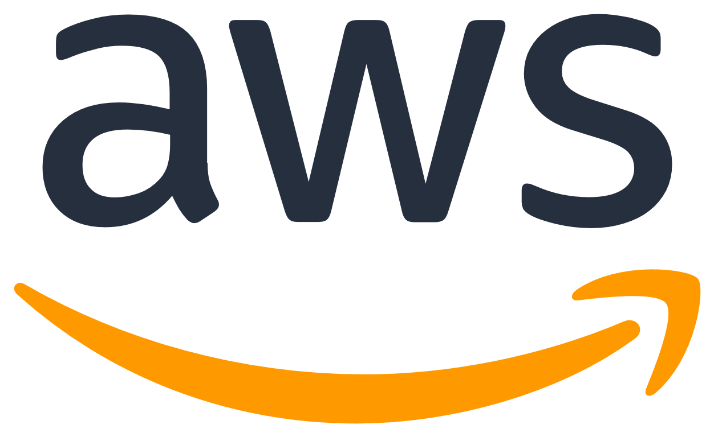


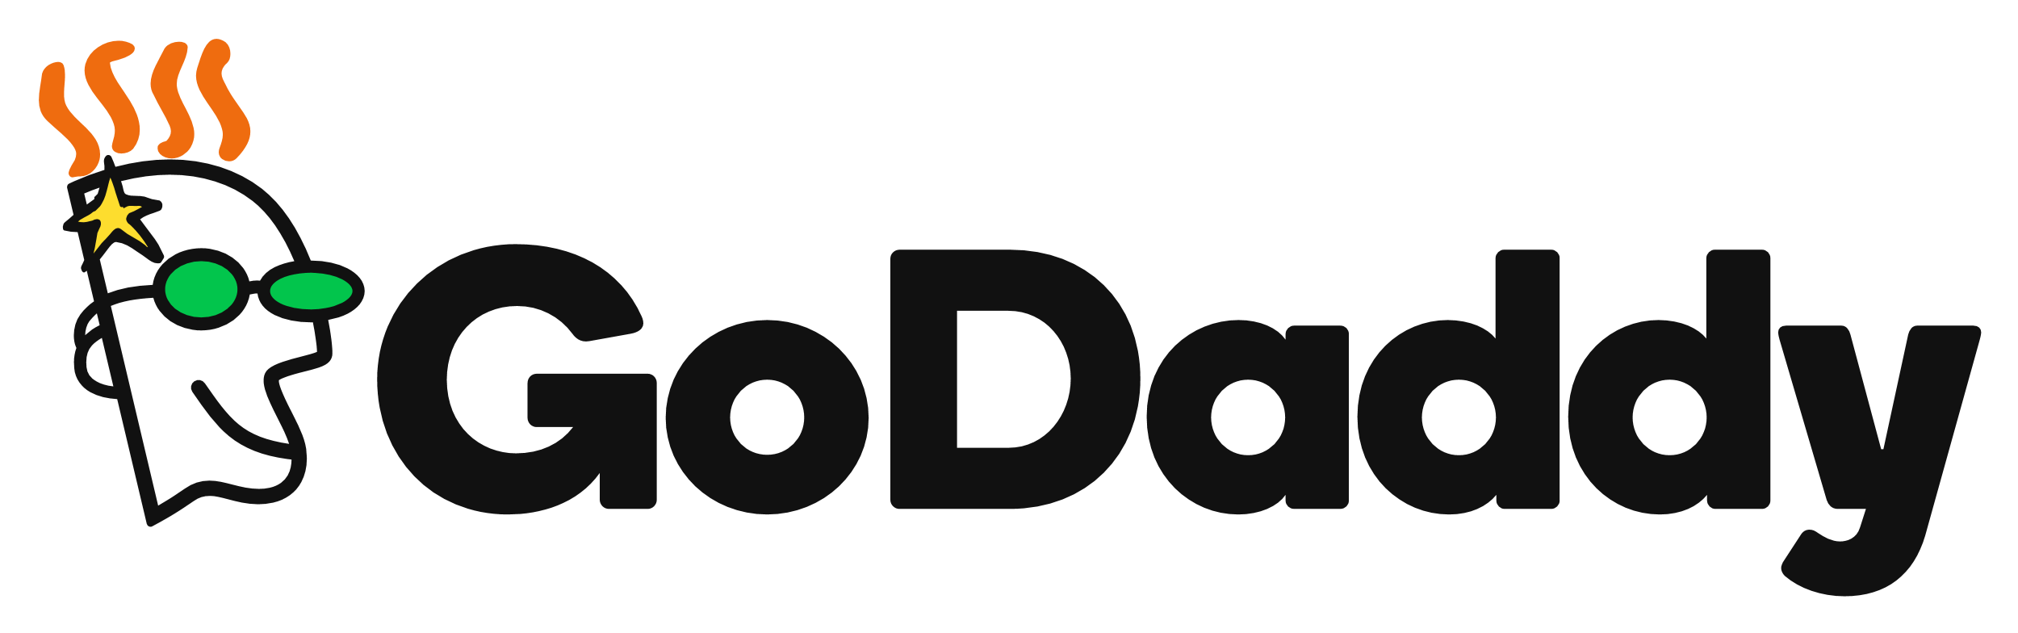


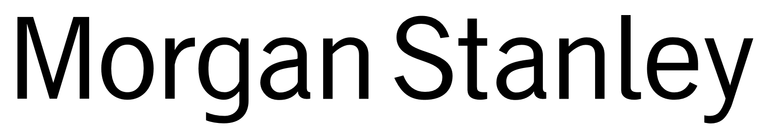

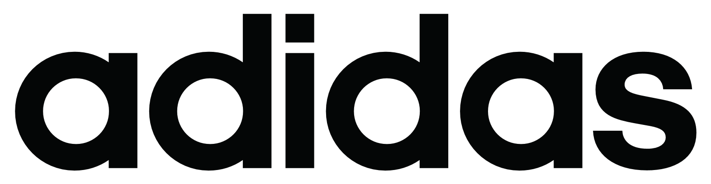

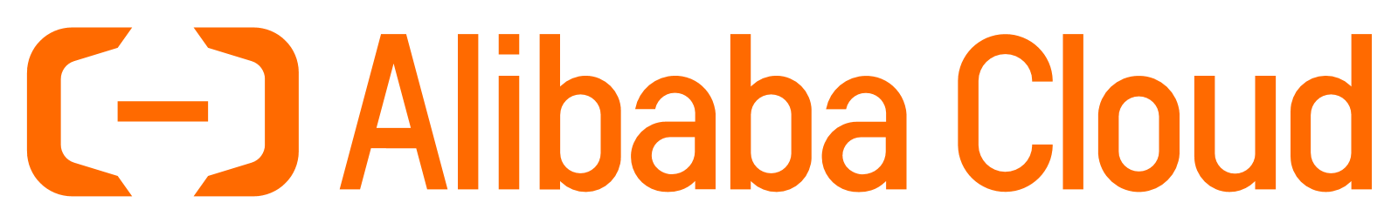

Foundation Members

Slide 11
Quiz!
Why Kubernetes has been called Kubernetes?
Why is it usually abbreviated with k8s?
Where is its logo coming from?
κυβερνήτης, Greek for "helmsman“
Simple! Just the number of characters between K and S
From Star Trek ex-Borg character Seven of Nine
Notes:
Original name in google was Project 7, a reference the Star Trek ex-Borg character Seven of Nine. The seven spokes on the wheel of the Kubernetes logo are a reference to that codename.

Slide 12
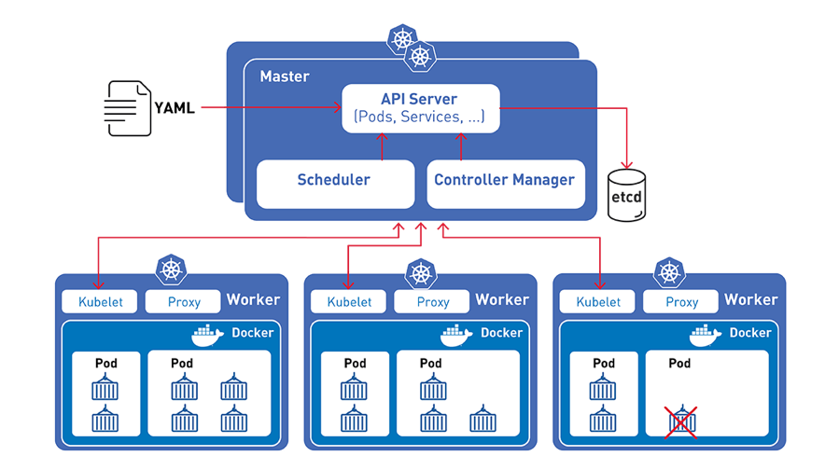
Kubernetes anatomy
Control plane
Notes:
kube-apiserver (main implementation) is a component of the control plane that exposes the Kubernetes API. Front end for the Kubernetes control plane. designed to scale horizontally
etcd consistent and highly-available key value store used as Kubernetes' backing store for all cluster data.
kube-scheduler component that watches for newly created Pods with no assigned node, and selects a node for them to run on.
kube-controller-manager component that runs controller processes like
Node controller: Responsible for noticing and responding when nodes go down.
Replication controller: Responsible for maintaining the correct number of pods for every replication controller object in the system.
Endpoints controller: Populates the Endpoints object (that is, joins Services & Pods).
Service Account & Token controllers: Create default accounts and API access tokens for new namespaces
cloud-controller-manager component that embeds cloud-specific control logic
kubelet agent that runs on each node in the cluster. It makes sure that containers are running in a Pod following the PodSpecs
kube-proxy is a network proxy that runs on each node in your cluster and maintains network rules on nodes. These network rules allow network communication to your Pods from network sessions inside or outside of your cluster.
container runtime is the software that is responsible for running containers. Docker is the most used but Kubernetes can run any container runtime like containerd (https://containerd.io/)

Slide 13
Master(s) and worker(s) nodes
master is responsible for managing the cluster
A worker node (aka node) is a VM or a physical computer that serves as a worker machine in a Kubernetes cluster
A master node (aka master) schedule the pods across all nodes taking into account the available resources of each node.
A worker node (aka node) is managed by the master node(s)
A node can have multiple pods

Slide 14
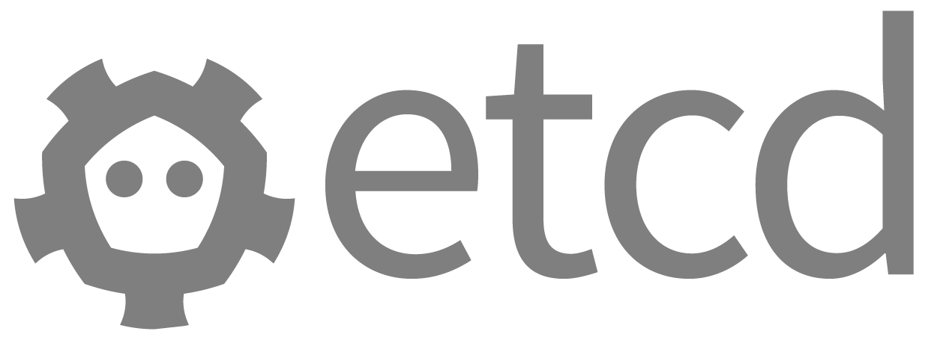
Kubernetes anatomy
Control plane
Notes:
kube-apiserver (main implementation) is a component of the control plane that exposes the Kubernetes API. Front end for the Kubernetes control plane. designed to scale horizontally
etcd consistent and highly-available key value store used as Kubernetes' backing store for all cluster data.
kube-scheduler component that watches for newly created Pods with no assigned node, and selects a node for them to run on.
kube-controller-manager component that runs controller processes like
Node controller: Responsible for noticing and responding when nodes go down.
Replication controller: Responsible for maintaining the correct number of pods for every replication controller object in the system.
Endpoints controller: Populates the Endpoints object (that is, joins Services & Pods).
Service Account & Token controllers: Create default accounts and API access tokens for new namespaces
cloud-controller-manager component that embeds cloud-specific control logic
kubelet agent that runs on each node in the cluster. It makes sure that containers are running in a Pod following the PodSpecs
kube-proxy is a network proxy that runs on each node in your cluster and maintains network rules on nodes. These network rules allow network communication to your Pods from network sessions inside or outside of your cluster.
container runtime is the software that is responsible for running containers. Docker is the most used but Kubernetes can run any container runtime like containerd (https://containerd.io/)

Slide 15
Kubernetes anatomy - Addons
Control plane
Addons use Kubernetes resources (DaemonSet, Deployment, etc) to implement cluster features.
DNS (kube-dns or CoreDns)
Cluster DNS is a DNS server, in addition to the other DNS server(s) in your environment, which serves DNS records for Kubernetes services
Web UI (Dashboard)
Container Resource Monitoring
Cluster-level Logging

Slide 16
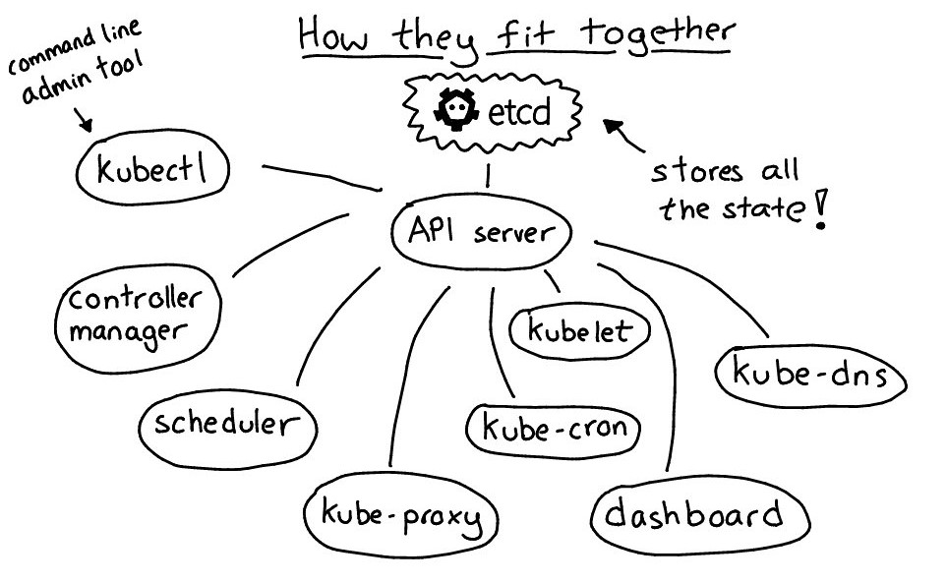
Kubernetes components – How the fit together?

Slide 17
Amazon Elastic Kubernetes Service
Control plane
In Abcam we have chosen AWS EKS to simplify the management and maintenance of Kubernetes clusters.
Managed control plane EKS provides a scalable and highly-available control plane that runs across multiple Availability Zones
Managed worker nodes groups (run nodes using the latest EKS-optimized AMIs)
Operational responsibility
Abcam | AWS
Application Container scaling (automated) Container/App Runtime Environment OS Patching (worker node) Networking (external to EKS) Permissions to other AWS resources | OS Install OS Patching (master) Kubernetes setup Kubernetes nodes management Container Platform Patching Server Maintenance Hardware Lifecycle Power/Network/HVAC
Notes:
Managed control plane EKS provides a scalable and highly-available control plane (api-server and etcd) that runs across three Availability Zones and it automatically detects and replaces unhealthy masters.
Managed worker nodes EKS lets you create, update, or terminate worker nodes for your cluster with a single command. Managed node groups run nodes using the latest EKS-optimized AMIs in your AWS account while updates and terminations gracefully drain nodes to ensure your applications stay available.

Slide 18
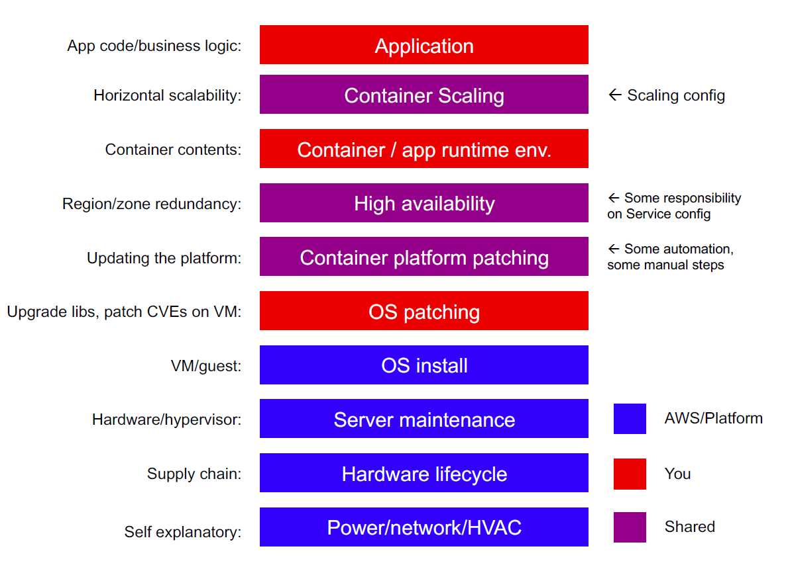
Amazon EKS
Control plane
Who is responsible for what?
Notes:
Managed control plane EKS provides a scalable and highly-available control plane (api-server and etcd) that runs across three Availability Zones and it automatically detects and replaces unhealthy masters.
Managed worker nodes EKS lets you create, update, or terminate worker nodes for your cluster with a single command. Managed node groups run nodes using the latest EKS-optimized AMIs in your AWS account while updates and terminations gracefully drain nodes to ensure your applications stay available.

Slide 19
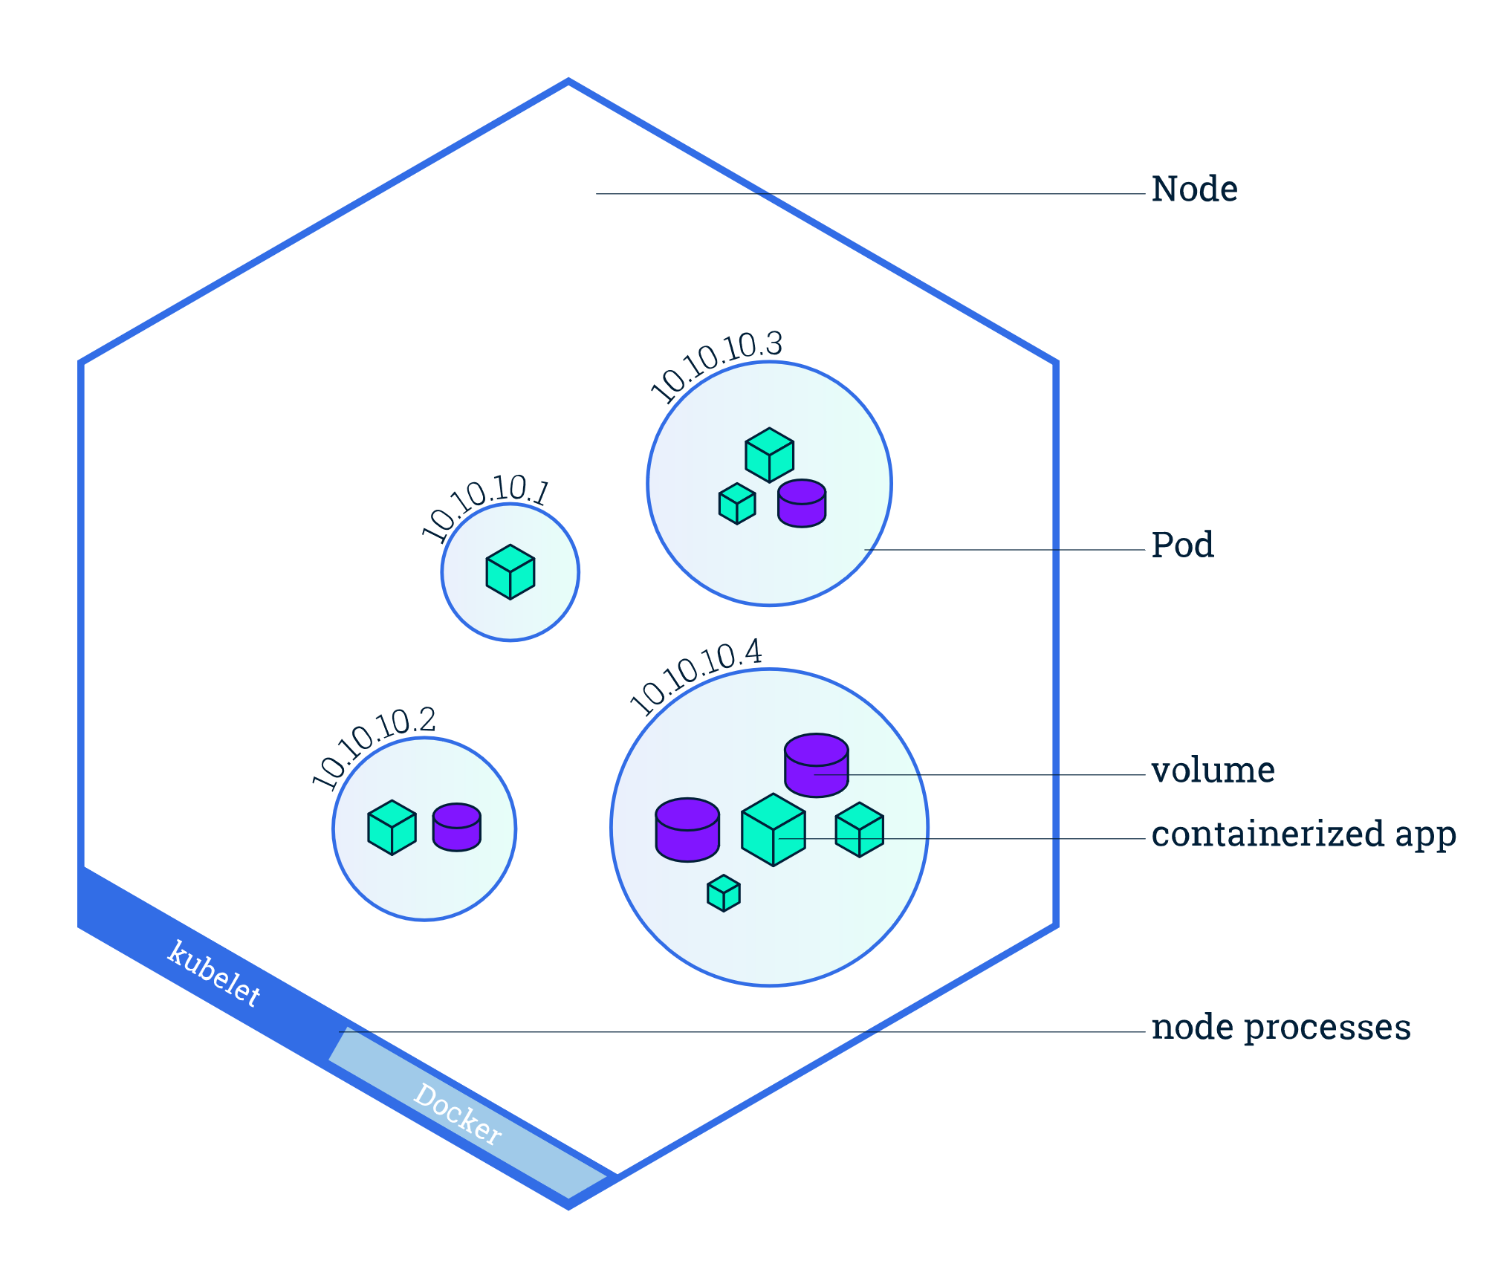
Pod
A Pod is the smallest deployable unit of computing in Kubernetes.
It is a resource envelope in which one or more containers run. Containers that are part of the same pod are guaranteed to be scheduled together onto the same machine, and can share state via local volumes.
Each Pod is assigned a unique IP address for each address family. Every container in a Pod shares the network namespace, including the IP address and network ports. Inside a pod, and only there, a container can speak with the other by localhost

Slide 20
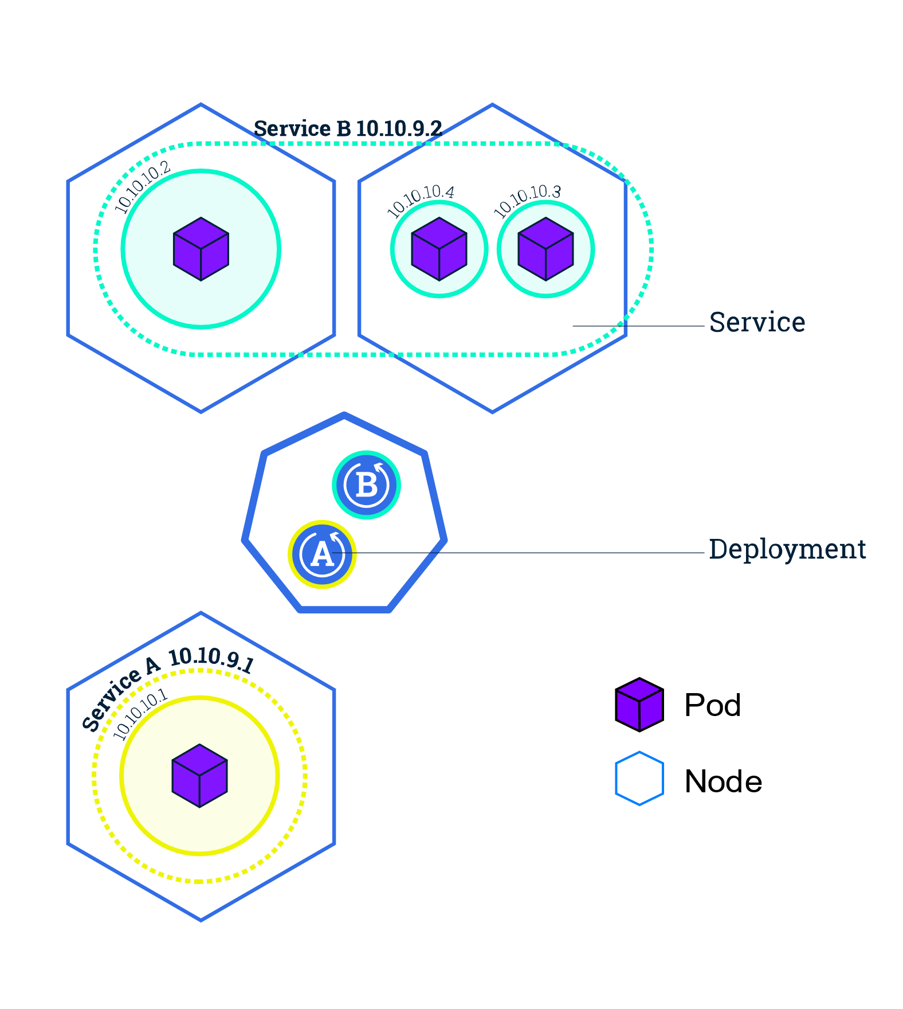
Service
A Service is an abstract way to expose an application running on a set of Pods as a network service.
A service has a name and maps to a dynamic set of pods defined by a label selector.
Any container in the cluster can connect to the service using the service name
Behind the scene, Kubernetes automatically load-balances connections to the service among the pods that match the label selector, and keeps track of where the pods are running as they get rescheduled over time due to failures.

Slide 21
Label
A Label is an arbitrary key/value pair that users attach to pods (and in fact to any object/resource in k8s)
Labels can be used to group collections of pods for deployment purposes or just describe resources with additional labels
Master will make use of label selector to select which set of pods an operation should be applied to.

Slide 22
Volume
At its core, a Volume is just a directory, possibly with some data in it, which is accessible to (and so shared by) the Containers in a Pod
Further reading about ways to provide long-term and temp storage to containers running in Kubernetes: https://kubernetes.io/docs/concepts/storage/

Slide 23
Access / expose a container
Although each Pod has a unique IP address, those IPs are not exposed outside the cluster without a Service.
Services allow your applications to receive traffic and can be expose in different ways (ServiceType):
ClusterIP
NodePort
LoadBalancer
ExternalName

Slide 24
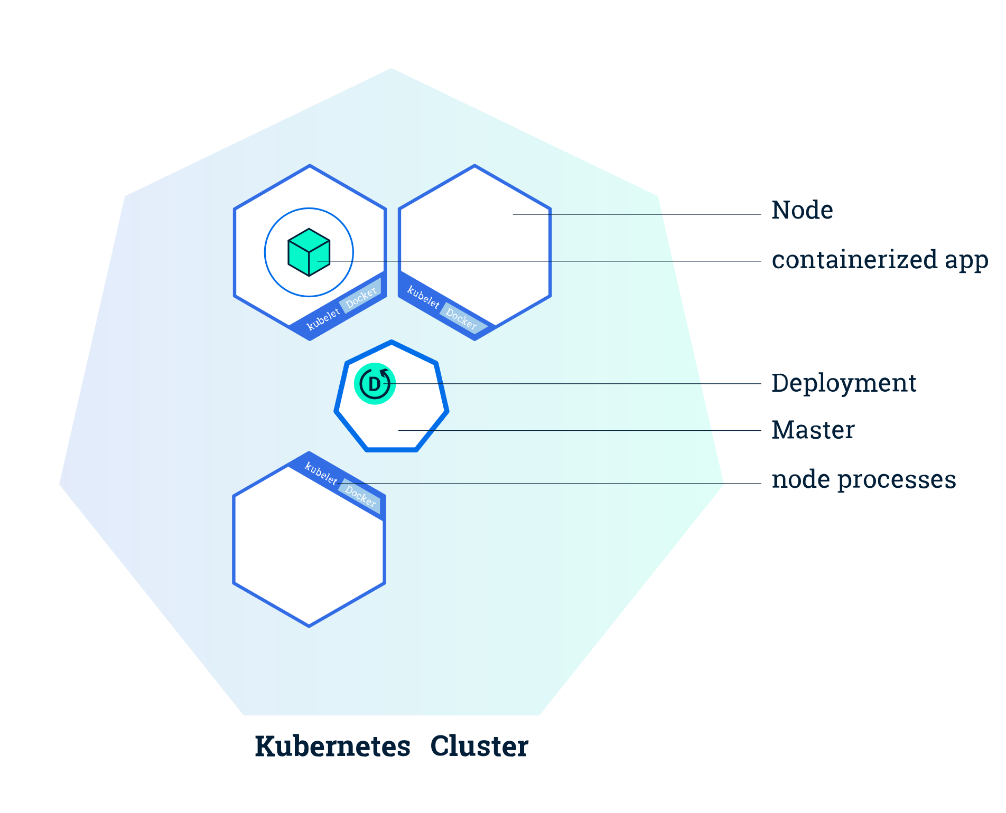
Kubernetes overview

Slide 25
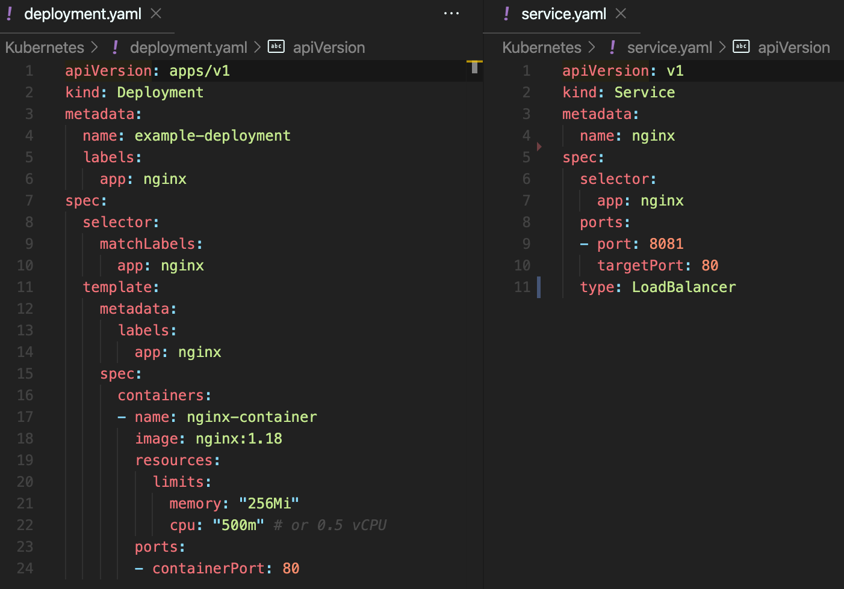
How does it look in practice?
Notes:
Jump on VS Code https://gitlab.abcam.com/diasella/friday-sessions/-/tree/master/Kubernetes

Slide 26
How to interact with a container?
kubectl, some examples:
kubectl create –f deployment.yaml
kubectl delete –f deployment.yaml
kubectl get pods --namespace pods-namespace
kubectl describe pod pod-name
kubectl logs pod-name
kubectl exec –it pod-name -- bash
Cheatsheet https://kubernetes.io/docs/reference/kubectl/cheatsheet/
Look familiar?
docker logs container-name
docker exec -it container-name bash

Slide 27
Recap
Deployment
ReplicaSet
Pod
Pod
Container
Container
Container
Container
Container image | Docker container image, contains your application code in an isolated environment.
Pod | A set of containers, sharing network namespace and local volumes, co-scheduled on one machine. Mortal Has pod IP Has labels
Deployment | Specify how many replicas of a pod should run on a cluster. Then ensure that many are running across the cluster Has labels
Service | Name things in DNS Gets virtual IP Routes requests based on label (using label selector)

Slide 28
Readings / Tutorials
Kubernetes official site kubernetes.io
Kubernetes Basics https://kubernetes.io/docs/tutorials/kubernetes-basics
Amazon EKS Workshop https://www.eksworkshop.com/
Kubernetes playground: https://www.katacoda.com/courses/kubernetes/playground

